Slide 1

NLP on Child COVID 19 Vaccination Tweets
By Amulya Gunturu & Shashank Kumar Reddy Chinthakuntla
Guided by Dr. Lisa Gandy

Slide 2

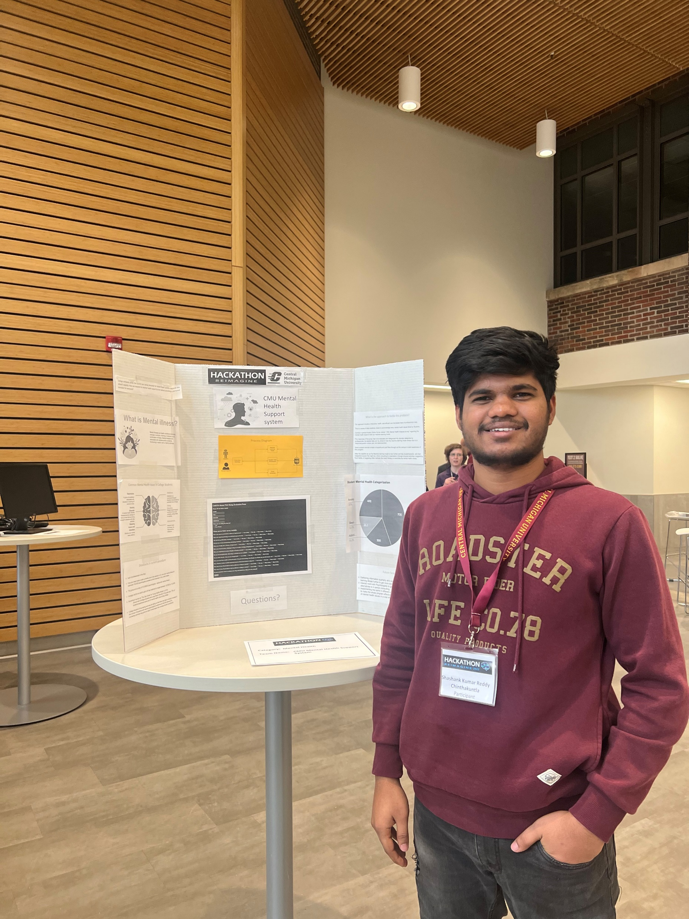
Introduction
Amulya Gunturu
Shashank Kumar Reddy Chinthakuntla

Slide 3
Contents
Project Goal
Twitter Premium API
Tweets Extraction
Tweets Wrangling
Data Analysis
Preprocessing of Tweets
Sentiment Analysis
Word2vec
Text generation using LSTM
LDA Topic modelling

Slide 4
Why Twitter Data?
Twitter is a social media network which is used by millions of people to express their views.
We have taken the tweets of CDCgov which are about the child vaccinations and having a minimum of 500 replies for that tweet.
Query to get it “Covid-19 (from:cdcgov) min_replies:500 -filter:replies”
Scraped data from twitter using tweepy and authenticated using twitter Premium API

Slide 5
Twitter APIs
Twitter used to provide Standard, Sandbox and Premium APIs in past.
Standard API is a free API and gives access to 7 days of data.
Sandbox is a paid API and gives access to 30 days of data
Premium API is also a paid API and gives access to full archives of data
Premium contains the following args:
query
tag
fromDate
toDate
maxResults
next

Slide 6
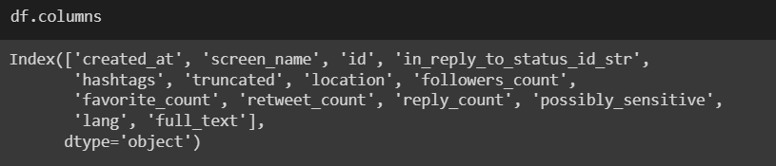
Tweets Extraction
CDC Tweets on Child COVID 19 Vaccination
All the Tweets were extracted in the format of JSON files
Converting all the JSON files to one CSV.

Slide 7
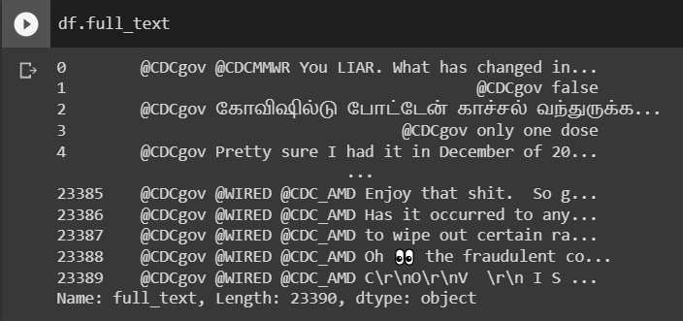
Tweets Wrangling
Reading the converted CSV File

Slide 8
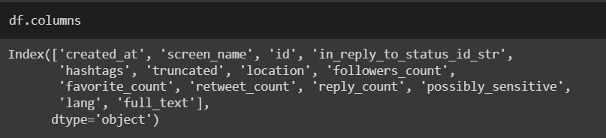
Tweets Wrangling
Reading only required fields

Slide 9
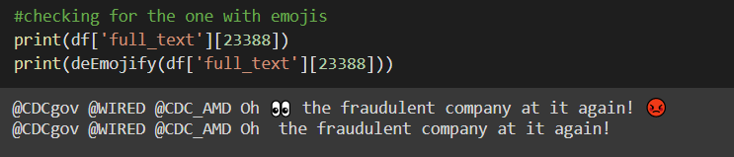
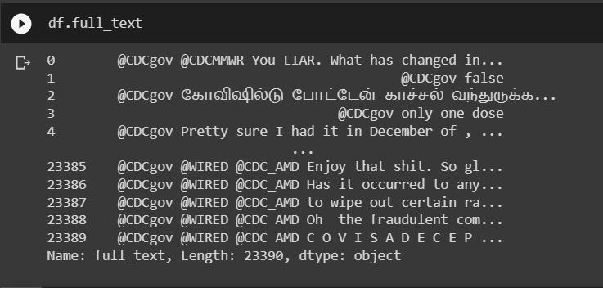
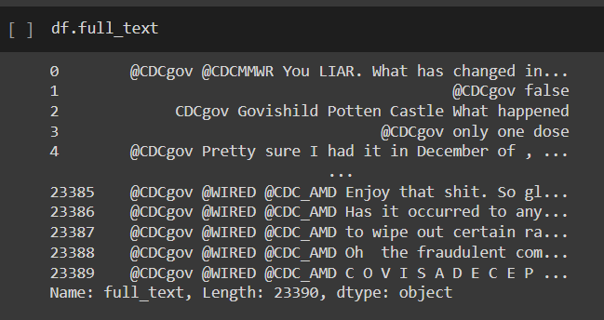
Tweets Wrangling
Removing Emojis
Translating other languages to English

Slide 10
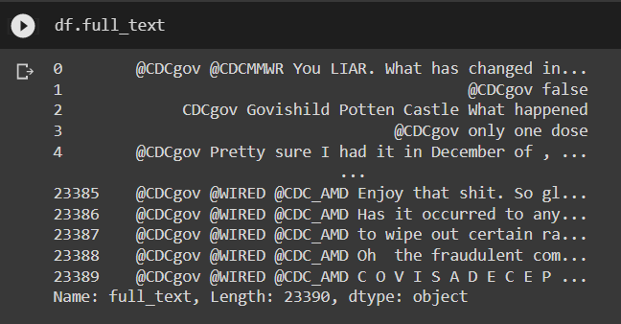
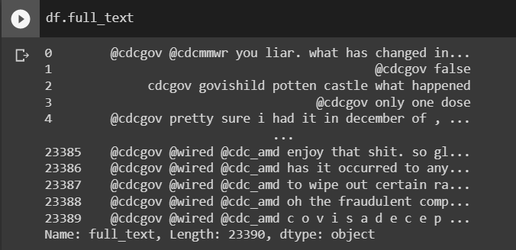
Tweet Wrangling
Lowercasing the Tweets text

Slide 11
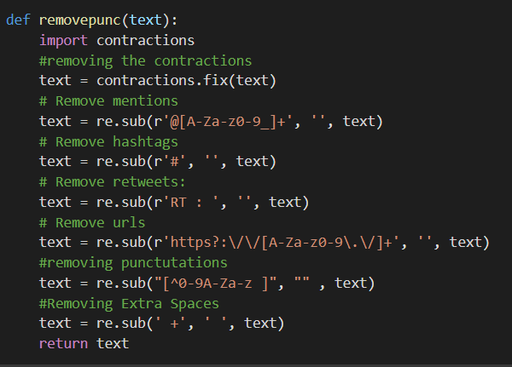
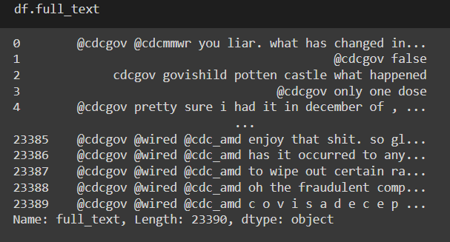
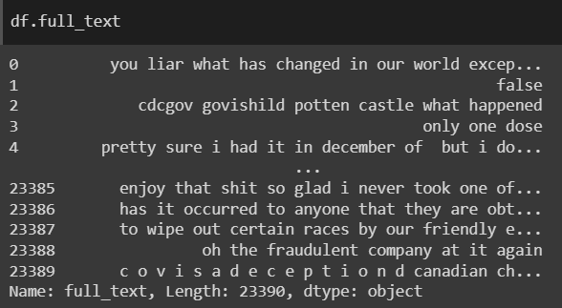
Tweets Wrangling
Removing Contractions, Punctuations, hashtags, URLs and @tags from tweets using RegEx

Slide 12


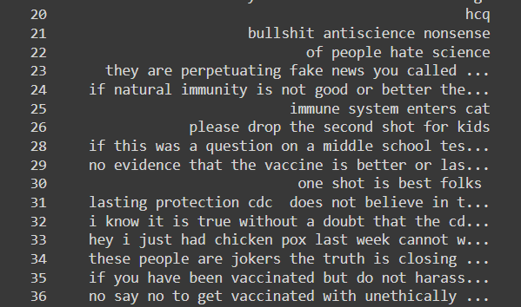
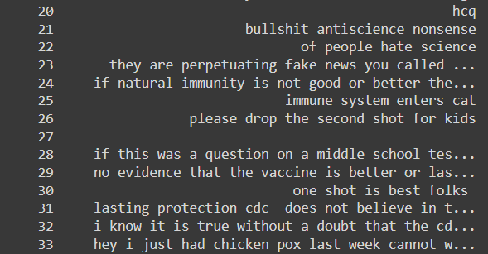
Tweets Wrangling
Dropping rows which have no Tweets text

Slide 13
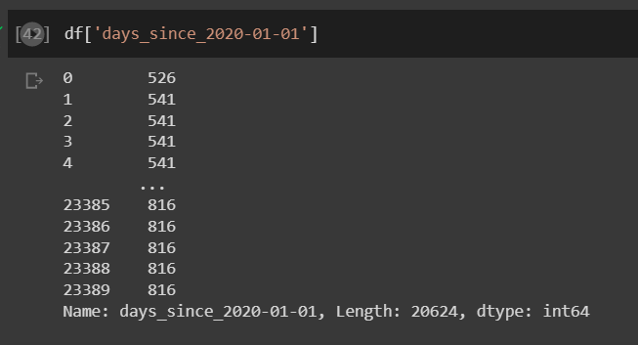
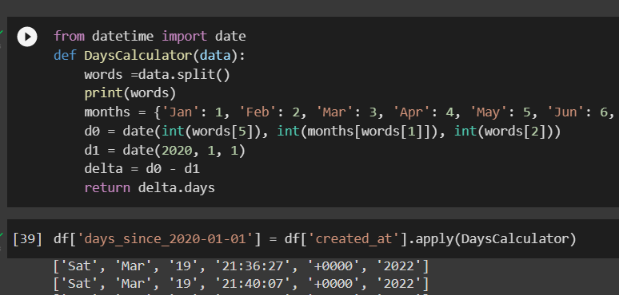
Data Analysis
Calculating Number of days since the tweet created from 2020-01-01

Slide 14
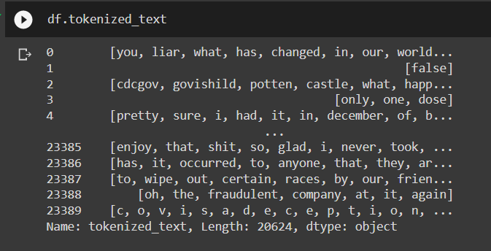
Pre-Processing Tweets
Tokenization of tweet text using NLTK

Slide 15
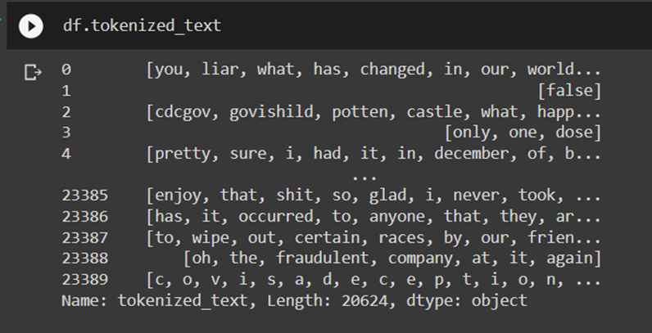
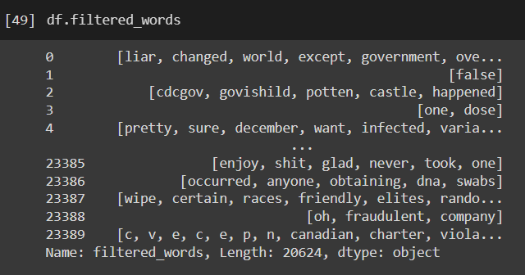
Pre-Processing Tweets
Removing stop words using NLTK

Slide 16
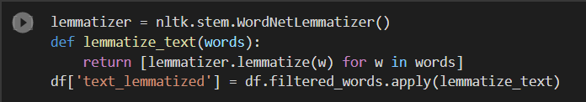
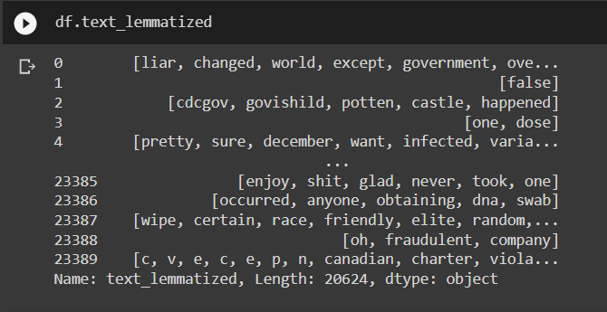
Pre-Processing Tweets
Lemmatizing text using NLTK

Slide 17
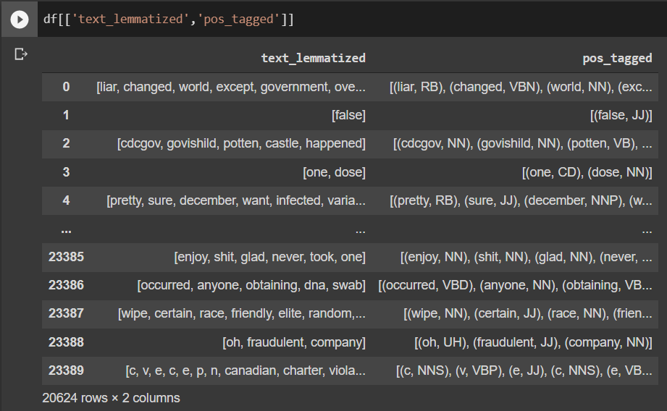
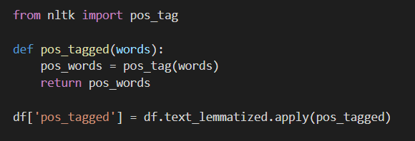
Pre-Processing Tweets
Parts of speech tagging using NLTK

Slide 18
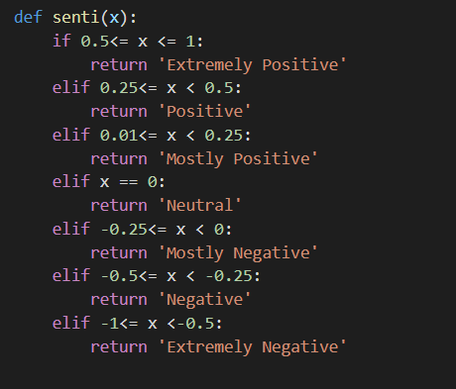
Sentiment Analysis using Text Blob
Polarity
Subjectivity

Slide 19
Sentiment Analysis using Text Blob
Neutral 8069
Mostly Positive 3723
Mostly Negative 2937
Negative 1971
Positive 1938
Extremely Positive 1104
Extremely Negative 814

Slide 20
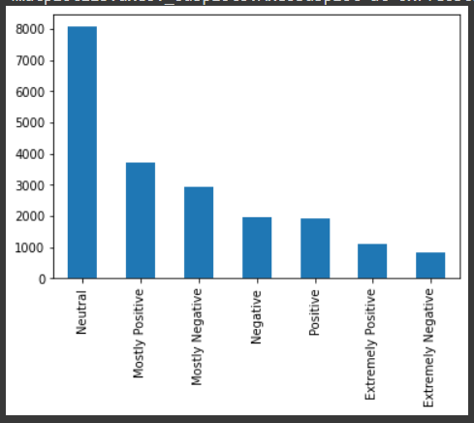
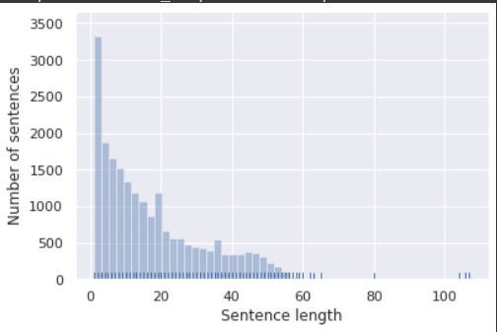

Slide 21
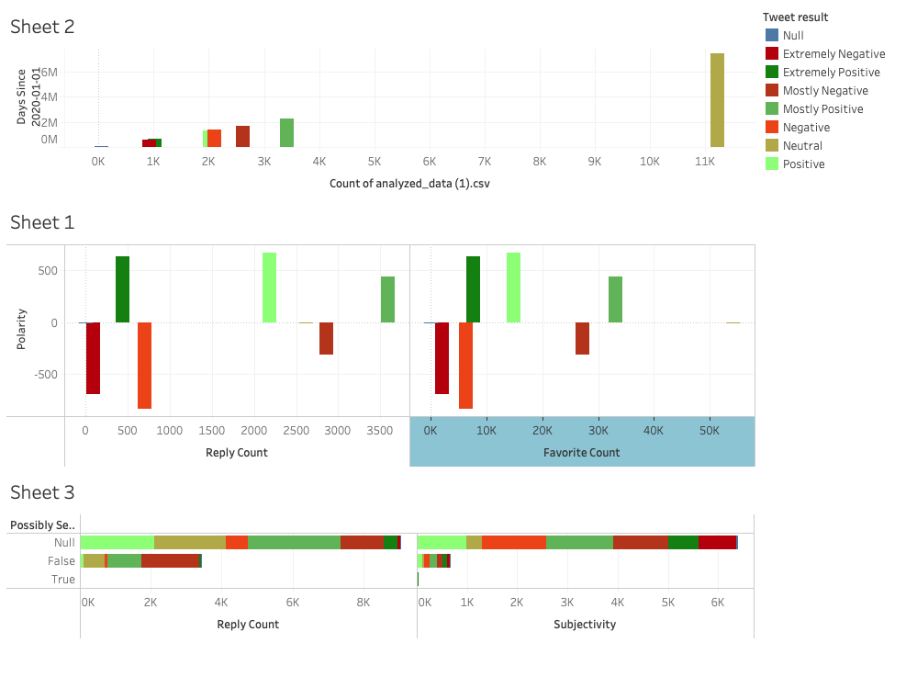
Data Visualization in Tableau

Slide 22
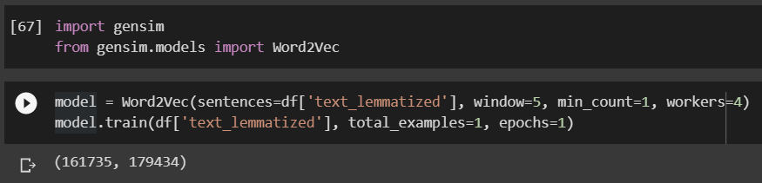
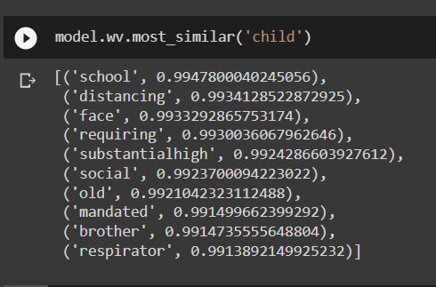
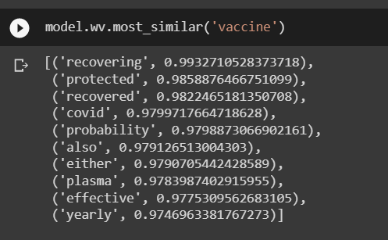
Word2Vec
Word Similarities using genism

Slide 23
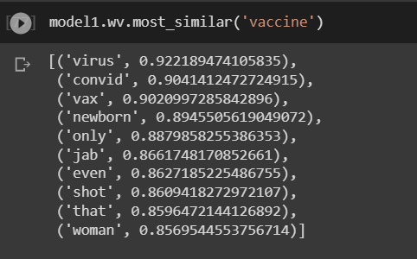
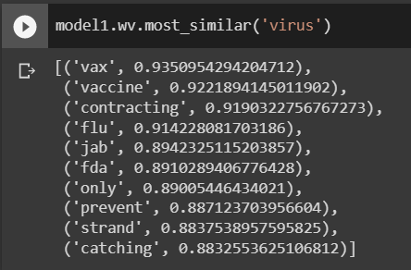
Word2Vec
Word Similarities using genism

Slide 24
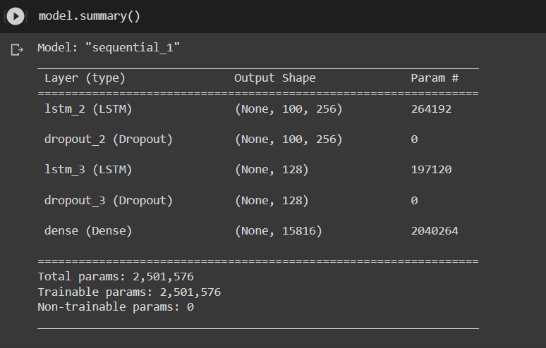
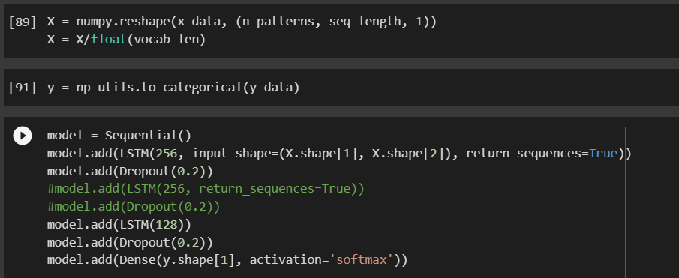
Text Generation using LSTM
LSTM model using Keras

Slide 25
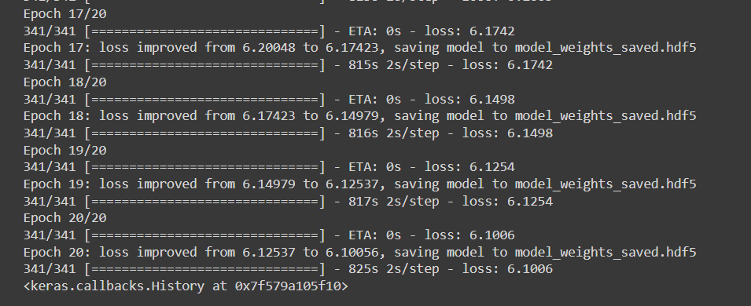
Text Generation using LSTM

Slide 26
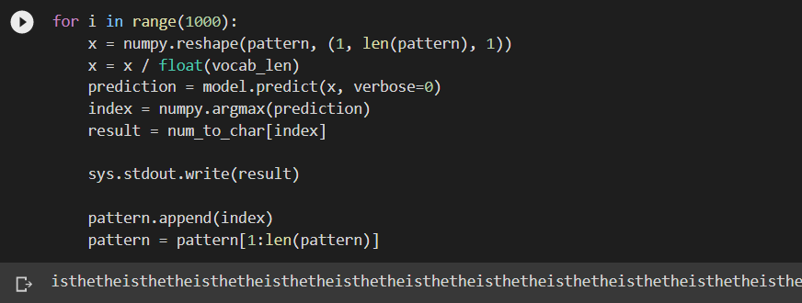
Text Generation using LSTM

Slide 27
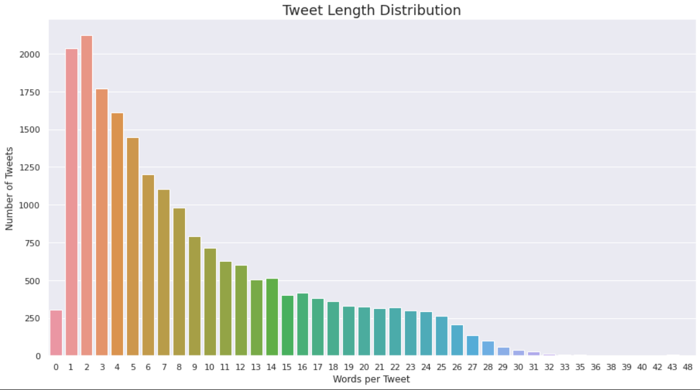
LDA Topic Modeling

Slide 28
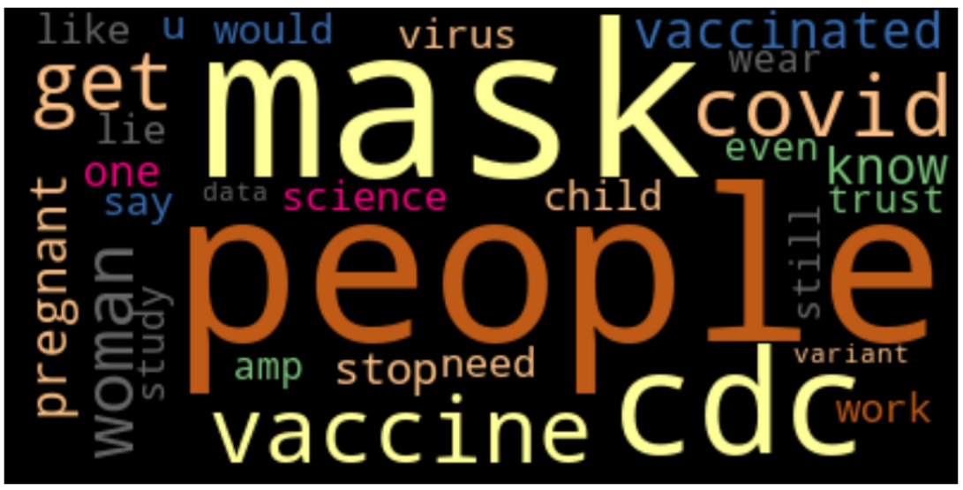
Word Cloud
Topmost common words in the tweets

Slide 29
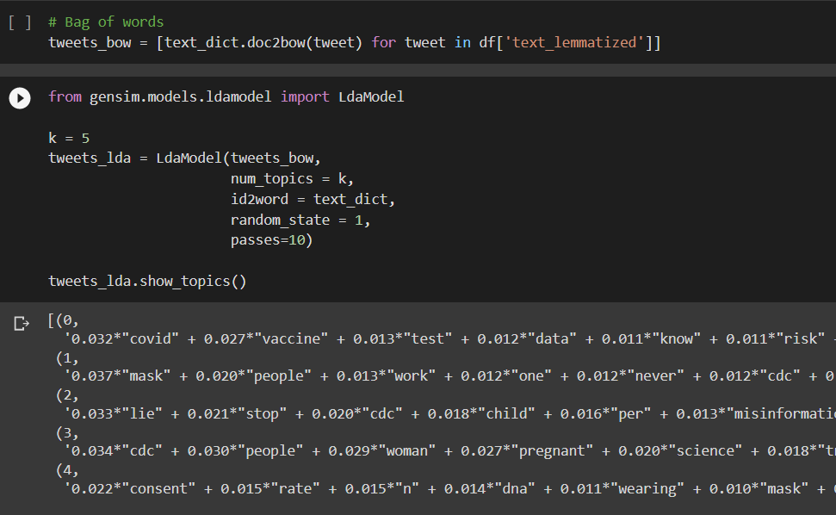
LDA Topic Modeling
Bag of words using genism

Slide 30
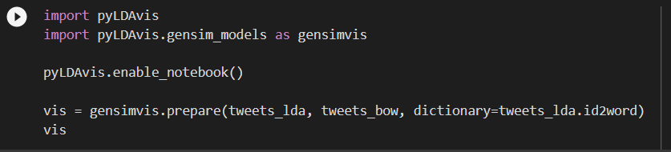
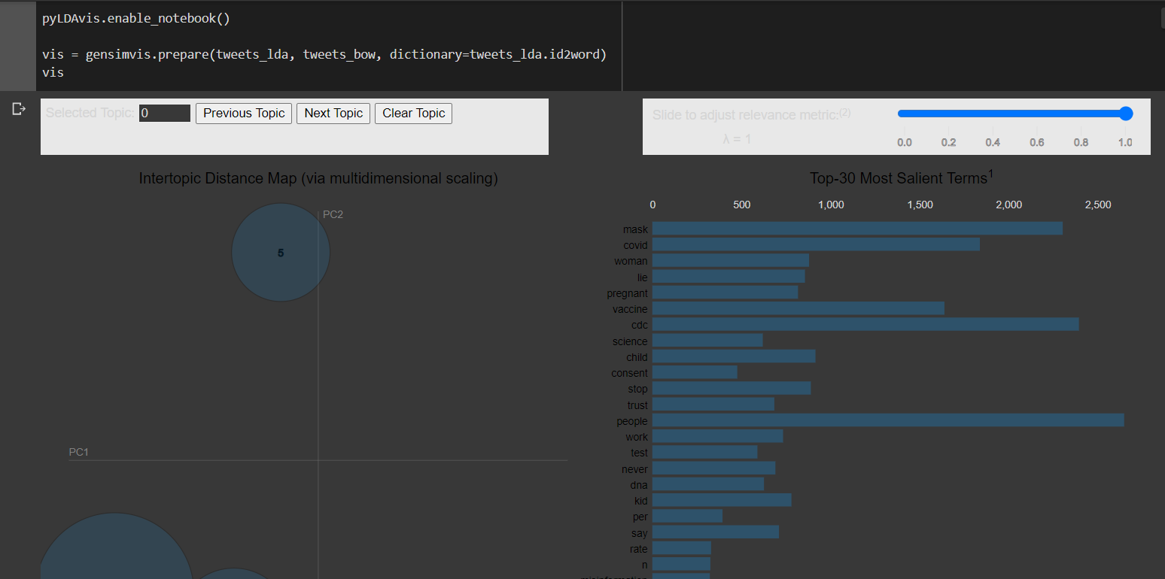
LDA Topic Modeling

Slide 31


